Slide 1


CROP RECOMMENDATION SYSTEM
USING MACHINE LEARNING

Slide 2

CONTENT
01
ABSTRACT
02
PROBLEM STATEMENT
03
INTRODUCTION
04
ARCHITECTURE DIAGRAM
05
EXISTING SYSTEM AND PROPOSED SYSTEM
06
MACHINE LEARNING MODELS
07
GAUSSIAN NAIVE BAYES ALGORITHM
08
FUTURE SCOPE
09
CONCLUSION

Slide 3
ABSTRACT
Agriculture plays a crucial role in sustaining global food security and economic growth. The success of agricultural endeavors heavily relies on selecting appropriatecrops based on diverse factors such as NPK levels, temperature, humidity,soil PH,rainfall. In recent years, advancements in machine learning have enabled the development of sophisticated crop recommendation systems that assist farmers and agronomists in making informed decisions.Technology based crop recommendation system for agriculture helps the farmers to increase the crop yield by recommending a suitable crop for their land.

Slide 4

PROBLEM STATEMENT
There are very few platforms that help farmers with their farming strategy. Intuition-based decisions may not prove beneficial in the long run. Farmers often underestimate/overestimate the fertility of the soil on their farms. However, farmers often face challenges in optimizing their crop selection. Using appropriate parameters like rain patterns, temperature patterns, soil structures, and other factors makes it possible to yield accurate crop prediction results. A lot of existing systems have many flaws and make them non-intuitive to use or are very difficult.
The goal of this system is to provide personalized crop recommendations to farmers based on a comprehensive analysis of multiple data sources and factors.

Slide 5
INTRODUCTION
A crop recommendation system using the Naive Bayes algorithm involves employing a probabilistic model to suggest suitable crops based on various factors like soil type, climate, and other relevant agricultural parameters. Naive Bayes, a machine learning technique, calculates the probability of a crop being suitable given certain conditions, making it a valuable tool for precision agriculture and optimizing crop selection for farmers.

Slide 6

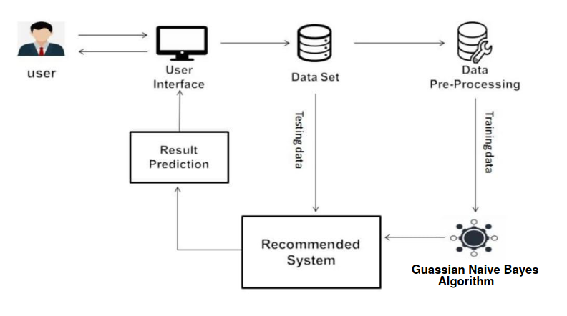
ARCHITECTURE DIAGRAM

Slide 7

EXISTING SYSTEM
There are various types of machine leraning algorithms that can be used for crop prediction including Logistic Regression,Decision Tree.
The accuracy that these machine learning models providing which is not meeting the expectations of farmers crop suitability to their land so that it may lead to crop failure in that soil.
In order to overcome the problems we introduces a new model

Slide 8
PROPOSED SYSTEM
Lets us observe the accuracy of the different algorithms:
Accuracy of the Logistic Regression:95.90%
Accuracy of the Decision Tree:92.5%
Accuracy of the Naive Bayes :99.54%

Slide 9
PROPOSED SYSTEM
The system that we introduced is called Navie Bayes machine leraning model which has a best accuracy rate in the crop prediction system which results accurate crop that suits for the soil.
After comparing and taking an analysis of the different machine learning algorithms we conclude that the Navie Bayes is the best one which has ahigh accuracy rate when compares to the exiting systems.

Slide 10
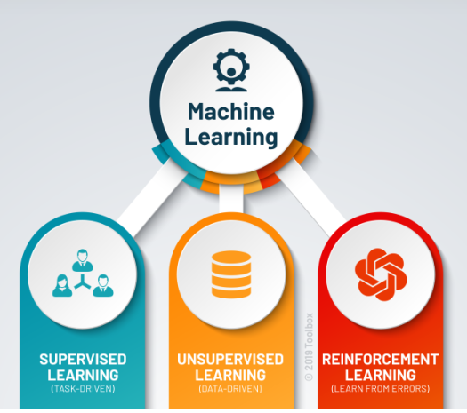
MACHINE LEARNING MODELS

Slide 11
GAUSSIAN NAIVE BAYES ALGORITHM
Naive Bayes algorithm is a supervised learning algorithm, which is based on Bayes theorem and used for solving classification problems.
Gaussian Naive Bayes (GNB) is a classification technique used in Machine Learning (ML) based on the probabilistic approach and Gaussian distribution.
It is a probabilistic classifier, which means it predicts on the basis of the probability of an object.
Naive Bayes Classifier is one of the simple and most effective Classification algorithms which helps in building the fast machine learning models that can make quick predictions.

Slide 12
ALGORITHM STEPS
Step 1: Gather Data
Collect data on various factors that influence crop growth, such as N,P,K Values,temperature,humidity, rainfall, soil ph, etc. Each set of data should be labeled with the corresponding recommended crop.
Step 2: Prepare the Data
Clean the data by handling missing values and outliers. Ensure the data is in a format suitable for analysis.
Step 3: Choose Features
Select the most relevant features that affect crop growth and recommendation, such as climate conditions or soil ph.
Step 4: Train the Model
Calculate Class Probabilities: Find the probability of each crop being recommended based on the data.
Calculate Feature Statistics: For each feature (e.g., temperature, humidity), calculate the mean and standard deviation for each crop class.

Slide 13
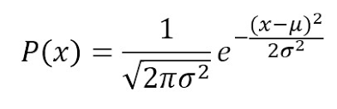
Step 5: Make Predictions
Gaussian Naive Bayes Formula: Use the Gaussian Naive Bayes formula for each feature to predict the likelihood of a certain crop given specific environmental conditions.
P(x) is the probability of feature x given class.
μ is the mean of the feature for class .
σ2 is the variance of the feature for class .
e is the base of the natural logarithm
Combine Probabilities: Combine the probabilities for all features to determine the most likely recommended crop.
Step 6: Evaluate and Refine
Test the model using a separate dataset. Evaluate its accuracy in predicting crop recommendations. Refine the model by adjusting feature selection or other parameters to improve accuracy if needed.
Step 7: Implement and Use
Apply the trained model to new sets of environmental data to recommend suitable crops based on the given conditions.

Slide 14
FUTURE SCOPE
The number of additional and other features can we added to the system.
At now currently, it take a necessary datasets as input from various government sites and KAGGLE and indicate a very appropriate crop to be cultivated.
But as in future, the automation property is added to the system as the response given to the feedback.
This can be updated such as that it will suggest the crop that give high production in that area and the crop will not harm the soil fertility and the environment due to some of it’s chemical components.

Slide 15
CONCLUSION
crop recommendation system is a valuable tool that shows the power of machine learning and data analysis to assist farmers in making informed decisions about crop selection..
crop recommendation system can provide personalized and well defined suggestions to farmers. This can lead to the farmers to cultivate a good crop to yeild the best crop results.

Slide 16

THANK YOU

